Slide 1
Cookbook for Practice 8.1
实践8.1攻略
Cong Li 李聪

Slide 2

Binary Logistic Regression
两类对数几率回归 (1)
Start a new file ‘logisticRegression.py’, import ‘numpy’ & ‘math’, create a class of ‘BinaryLogisticRegression’, & in its initialization function take 4 input parameters for the regularization parameter, tolerance in gradient descent, maximum number of iterations, & learning rate.
开启一个新文件“logisticRegression.py”，导入“numpy”和“math”，创建“BinaryLogisticRegression”类型，并在其初始化函数中接受4个参数：调整参数、损失变化容忍度、最大训练轮数的参数和学习速度。

Slide 3


Binary Logistic Regression
两类对数几率回归 (2)
Use 4 member variables to store those parameters
用4个成员变量存储这些参数
Assuming two member variables of the class, bias b & weight array w, are properly maintained, write a scoring member function to calculate the score of an input data sample
假设我们恰当地维持着偏向b和权重w数组这两个成员变量，写一个计分的成员函数来计算某个给定输入数据的得分

Slide 4


Binary Logistic Regression
两类对数几率回归 (3)
Write another member function for classification based on the score 再写一个成员函数，基于得分进行分类
Use a member function to translate the class label of negative samples from -1 to 0
用一个成员函数把反例的类别标记从-1转化成0

Slide 5
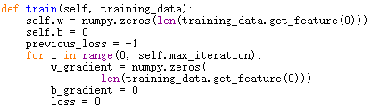
Binary Logistic Regression
两类对数几率回归 (4)
Now we come to the training part. At the beginning, initialize the weights & bias. Use a temporarily variable to record the previous loss. In each iteration of training, initialize the gradients & the loss.
现在我们进入训练部分。一开始，初始化权重和偏向，用一个临时变量记录上一轮的损失。在每一轮训练开始之际初始化梯度和损失

Slide 6
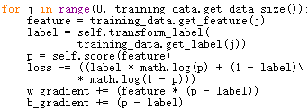
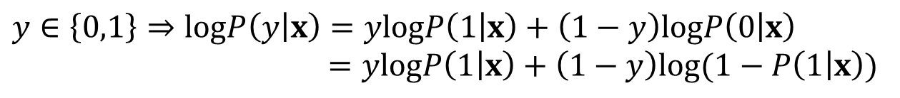
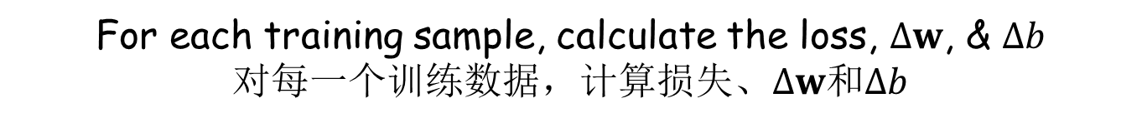
Binary Logistic Regression
两类对数几率回归 (5)
For each training sample, calculate the loss, $∆w$, & $∆b$
对每一个训练数据，计算损失、$∆w$和$∆b$
$$y∈\left\{0,1\right\}⇒logP\left(y | x\right)=y\text{log}P\left(1 | x\right)+\left(1−y\right)\text{log}P\left(0 | x\right)$$
$$=y\text{log}P\left(1 | x\right)+\left(1−y\right)\text{log}(1−P\left(1 | x\right))$$

Slide 7


Binary Logistic Regression
两类对数几率回归 (6)
Add the regularization term & print the loss
加入调整项，输出损失
Compare w/ the previous loss. Stop training if the change is within the tolerance. Otherwise update the previous loss
和上一轮的损失进行比较，如果变化小于容忍度，则终止训练。否则更新上一轮的损失

Slide 8

Binary Logistic Regression
两类对数几率回归 (7)
Add the regularization term part to the weight components in the gradient. Divide the gradients w/ the training data size. Update the weights & the bias
为权重部分的梯度加入调整项相关的部分。将梯度除以训练数据量。最后更新权重和偏向

Slide 9


Run It 运行之
Based on Practice 4.1, in file ‘test.py’, now replace the nearest neighbor related lines w/ the logistic regression related lines
基于实践4.1，把最近邻相关的语句换成对数几率回归相关的语句
Run w/ the command line below 用以下命令行运行
test.py 20

Slide 10
The End

